Slide 1
COMP90054 AI Planning for Autonomy Workshop - 1
Notes:
Slides by Siahuo

Slide 2
About your tutor
Name: Anam Ahmad Khan
Email: anam.khan@unimelb.edu.au
Final year PhD student in the School of CIS
My research applies machine learning and HCI

Slide 3
Objectives of today’s workshop:
Question 1: State Model
Question 2: Blind Search Algorithm: BFS, DFS, ID

Slide 4


Slide 5
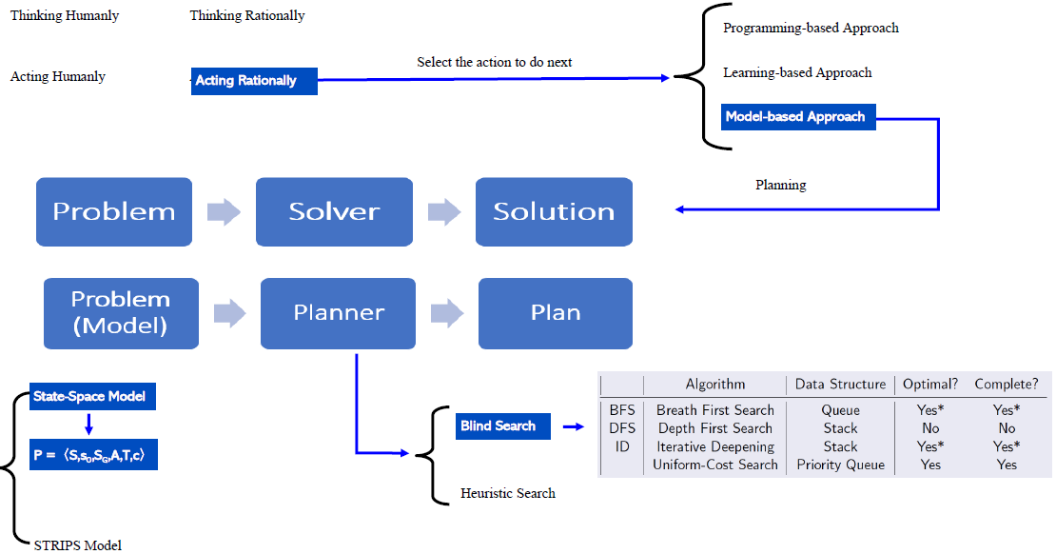

Slide 6
State Model
• State space S • Initial state s₀ ∈ S • Set of goal states s_{G} ⊆ S
• Applicable actions function A(s) for each state s ∈ S
• Transition function f (s, a) for s ∈ S and a ∈ A(s) • Cost of each action c(a, s) for s ∈ S and a ∈ A(s)

Slide 7
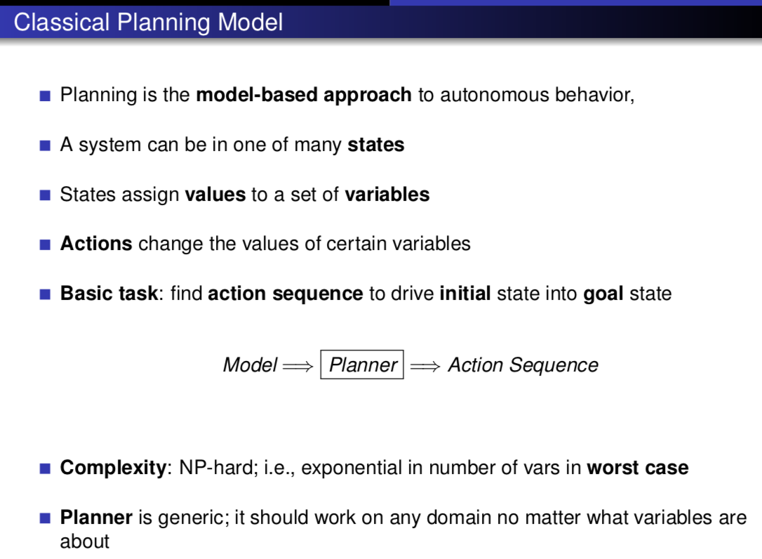

Slide 8
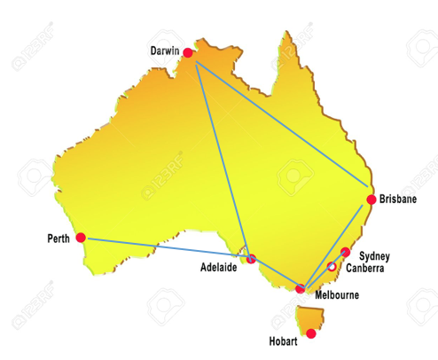
Travelling Salesman Problem
Consider:
A set of cities V to visit in any order
A starting city location v_{start}
A set of edges E specifying if there is an edge between two cities <v, v’>
State space
{Current city, Visited cities}
Notes:
• A state space is a set of descriptions or states.

Slide 9
State Model
• State space S • Initial state s₀ ∈ S • Set of goal states s_{G} ⊆ S
• Applicable actions function A(s) for each state s ∈ S
• Transition function f (s, a) for s ∈ S and a ∈ A(s) • Cost of each action c(a, s) for s ∈ S and a ∈ A(s)

Slide 10



State space
{Current city, Visited cities}
Travelling Salesman Problem
Initial State
Applicable actions function
Cost of each action
Transition function
Goal State

Slide 11
8-Puzzle Problem
2 | 4 | 1
5 | 6
3 | 7 | 8
1 | 2 | 3
4 | 5 | 6
7 | 8
Initial state
Goal state
Moves: up, down, left, right

Slide 12
Blind Search Algorithms :
Only use the basic ingredients for general search algorithms.
Depth First Search (DFS)
Breadth-first (BrFS)
Uniform Cost (Dijkssearchtra)
Iterative Deepening (ID)
Heuristic Search Algorithms :
Additionally use heuristic functions which estimate the distance (or remaining cost) to the goal.
A*
WA*
Hill Climbling
Greedy Best First Search
Notes:
Blind Search - searching without information. For example : BFS (one of blind search method). We just generate all successor state (child node) for currentstate (current node) and find is there a goal state among them, if isn't we will generate one of child node's successor and so on. Because we don't have information, so just generate all.
Heuristic Search- searching with information. Heuristic search algorithms: Additionally use heuristic functions which estimate the distance (or remaining cost) to the goal..
Blind Search - searching without information. For example : BFS (one of blind search method). We just generate all successor state (child node) for currentstate (current node) and find is there a goal state among them, if isn't we will generate one of child node's successor and so on. Because we don't have information, so just generate all.
Heuristic Seach- searching with information. For example : A* Algorithm. We choose our next state based on cost and 'heuristic information' with heuristic function.
Case Example : find shortest path. with Blind search we just trying all location (brute force). with Heuristic, say we have information about distance between start point and each available location. We will use that to determine next location.

Slide 13
Properties
Optimality
Are the returned solutions guaranteed to be optimal?
Completeness
Is the strategy guaranteed to find a solution when there is one?
Sound
Is the algorithm guaranteed to return correct answers?

Slide 14
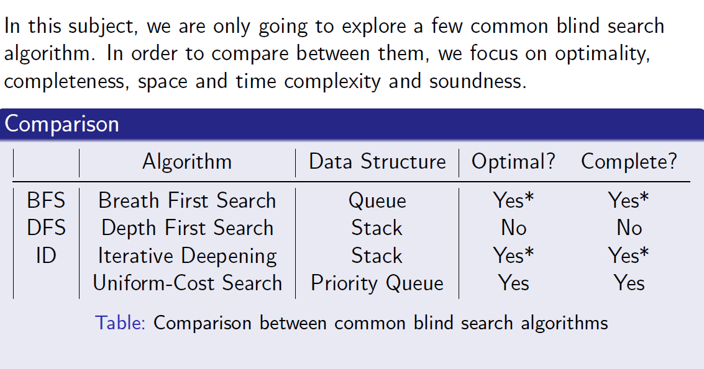
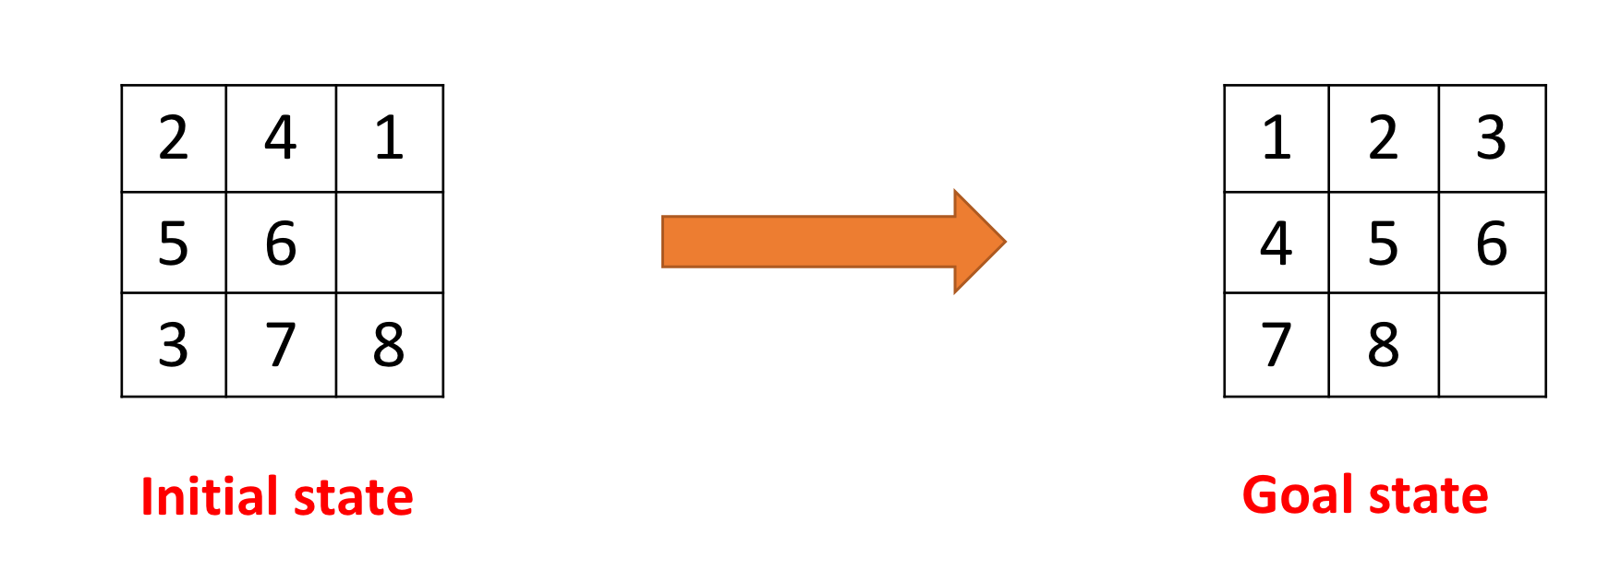
Initial state:
s0 = {2,4,1,5,6,_,3,7,8}
Goal state:
s0 = {1,2,3,4,5,6,7,8,_}
Notes:
sLIDES

Slide 15
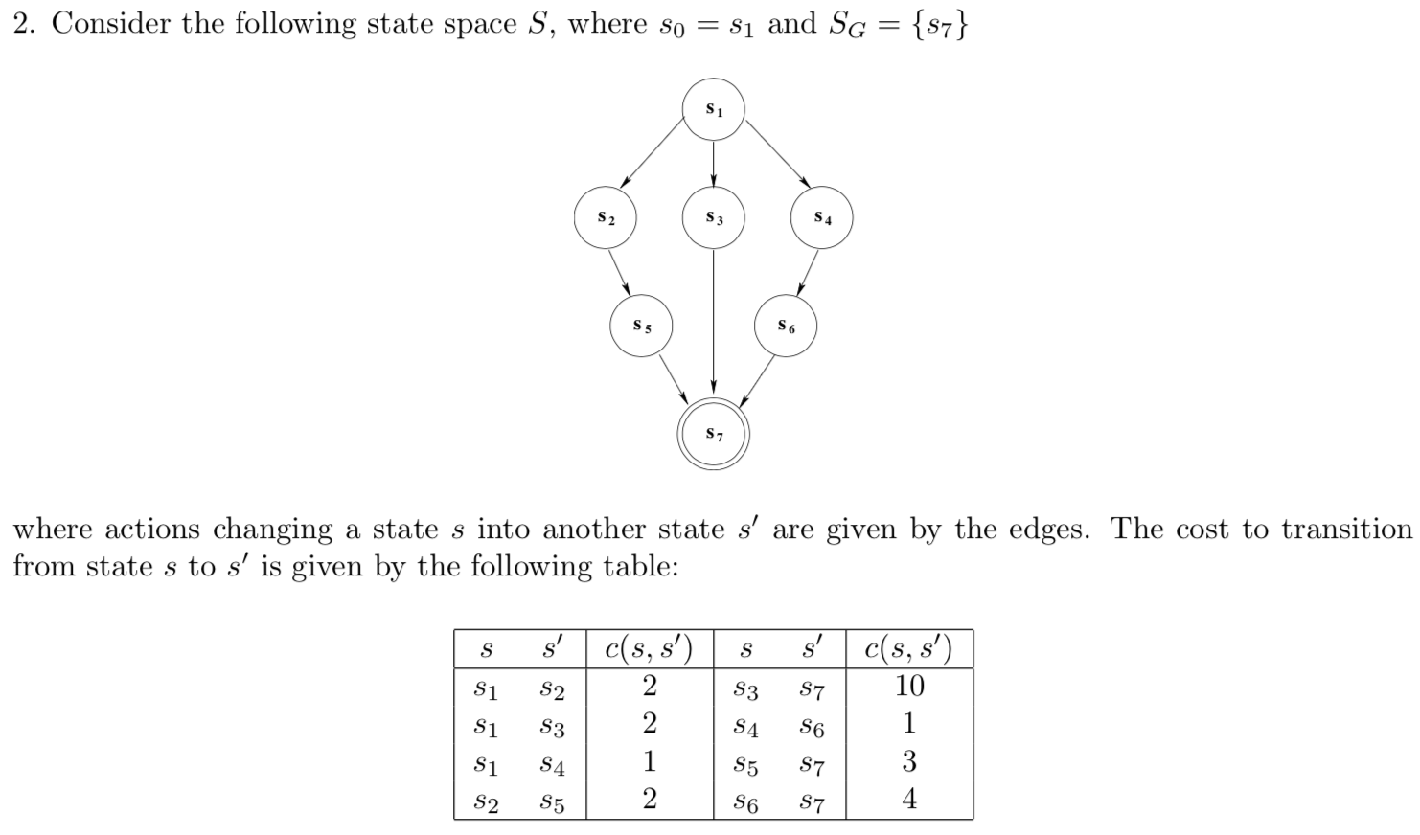
initial state
2
2
1
2
1
10
3
4
goal state

Slide 16
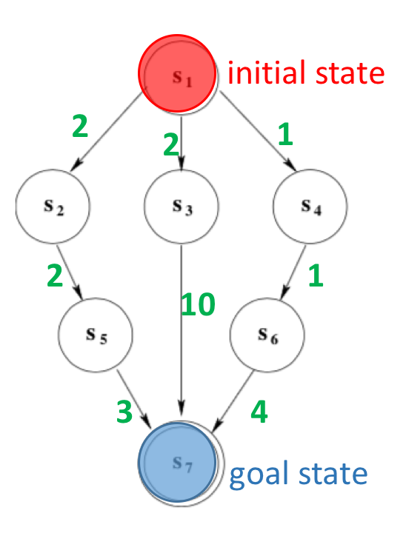
1.BFS
n3 = ⟨ s3, g(n), n_{parent} ⟩
Ordered Sequence of States expanded
n1 = < s1, 0, -- >
n3 = < s3, 2, n1 >

Slide 17
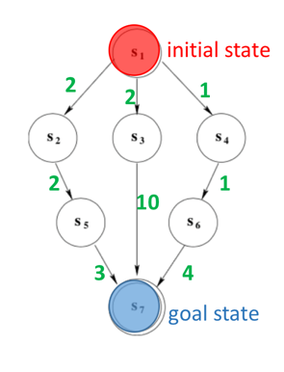
 | 1st stage | 2nd stage
Open | n1 = < s1, 0, -- > | n2 = < s2, 2, n1 > n3 = < s3, 2, n1 > n4 = < s4, 1, n1 >
Closed |  | n1 = < s1, 0, -- >
 | 3rd stage | 4th stage | 5th Stage
Open | n3 = < s3, 2, n1 > n4 = < s4, 1, n1 > n5 = < s5, 4, n2 > | n4 = < s4, 1, n1 > n5 = < s5, 4, n2 > n6 = < s7, 12, n3 > | n5 = < s5, 4, n2 > n6 = < s7, 12, n3 > n7 = < s6, 2, n4 >
Closed | n2 = < s2, 2, n1 > n1 = < s1, 0, -- > | n3 = < s3, 2, n1 > n2 = < s2, 2, n1 > n1 = < s1, 0, -- > | n4 = < s4, 1, n1 > n3 = < s3, 2, n1 > n2 = < s2, 2, n1 > n1 = < s1, 0, -- >
 | 6th stage | 4th stage | 5th Stage
Open | n3 = < s3, 2, n1 > n4 = < s4, 1, n1 > n5 = < s5, 4, n2 > | n4 = < s4, 1, n1 > n5 = < s5, 4, n2 > n6 = < s7, 12, n3 > | n5 = < s5, 4, n2 > n6 = < s7, 12, n3 > n7 = < s6, 2, n4 >
Closed | n5 = < s5, 4, n2 > n4 = < s4, 1, n1 > n3 = < s3, 2, n1 > n2 = < s2, 2, n1 > n1 = < s1, 0, -- > | n3 = < s3, 2, n1 > n2 = < s2, 2, n1 > n1 = < s1, 0, -- > | n4 = < s4, 1, n1 > n3 = < s3, 2, n1 > n2 = < s2, 2, n1 > n1 = < s1, 0, -- >

Slide 18
 | 3rd stage | 4th stage | 5th Stage
Open | n3 = < s3, 2, n1 > n4 = < s4, 1, n1 > n5 = < s5, 4, n2 > | n4 = < s4, 1, n1 > n5 = < s5, 4, n2 > n6 = < s7, 12, n3 > | n5 = < s5, 4, n2 > n6 = < s7, 12, n3 > n7 = < s6, 2, n4 >
Closed | n2 = < s2, 2, n1 > n1 = < s1, 0, -- > | n3 = < s3, 2, n1 > n2 = < s2, 2, n1 > n1 = < s1, 0, -- > | n4 = < s4, 1, n1 > n3 = < s3, 2, n1 > n2 = < s2, 2, n1 > n1 = < s1, 0, -- >
 | 6th stage | 4th stage
Open | n6 = < s7, 12, n3> n7 = < s6, 2, n4 > n8 = < s7, 7, n5 > | n7 = < s6, 2, n4 > n8 = < s7, 7, n5 >`
Closed | n5 = < s5, 4, n2 > n4 = < s4, 1, n1 > n3 = < s3, 2, n1 > n2 = < s2, 2, n1 > n1 = < s1, 0, -- > | n6 = < s7, 12, n3> n5 = < s5, 4, n2 > n4 = < s4, 1, n1 > n3 = < s3, 2, n1 > n2 = < s2, 2, n1 > n1 = < s1, 0, -- >
The solution found by BFS: s1 -> s3 -> s7
The solution is not optimal
BFS will be optimal if the costs are uniform, e.g. all costs are 1

Slide 19
2. DFS
Any one of 3 possible solutions:
s1 -> s2 -> s5 -> s7 cost = 2 + 2 + 3 = 7
s1 -> s3 -> s7 cost = 2 + 10 = 12
s1 -> s4 -> s6 -> s7 cost = 1 + 1 + 4 = 6
DFS can not guarantee optimality
Notes:
Optimality? No. After all, the algorithm just “chooses some direction and hopes for the best”. (Depth-first search is a way of “hoping to get lucky”.) Completeness? No, because search branches may be infinitely long: No check for cycles along a branch! → Depth-first search is complete in case the state space is acyclic, e.g., Constraint Satisfaction Problems. If we do add a cycle check, it becomes complete for finite state spaces.

Slide 20
3. Iterative Deepening
depth bound= 0
Depth = 0
Depth = 1
 | 1st stage | 2nd stage
Open
Closed
n1 = < s1, 0, -- >
Depth = 2
n1 = < s1, 0, -- >
Depth = 3
Ordered Sequence of States expanded

Slide 21
3. Iterative Deepening
depth bound= 1
Depth = 0
 | 1st stage | 2nd stage | 3rd stage
Open
Closed
Depth = 1
n1 = < s1, 0, -- >
n2 = < s2, 2, n1 >
n3 = < s3, 2, n1 >
Depth = 2
n4 = < s4, 1, n1 >
n1 = < s1, 0, -- >
n1 = < s1, 0, -- >
Depth = 3
n2 = < s2, 2, n1 >
n3 = < s3, 2, n1 >
n4 = < s4, 1, n1 >
Ordered Sequence of States expanded

Slide 22
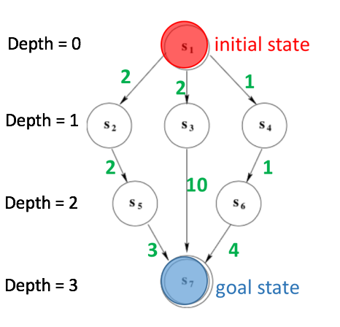
3. Iterative Deepening
depth bound= 2
 | 1st stage | 2nd stage
Open
Closed
n1 = < s1, 0, -- >
n2 = < s2, 2, n1 >
n3 = < s3, 2, n1 >
n4 = < s4, 1, n1 >
n1 = < s1, 0, -- >
 | 3rd stage | 4th stage | 5th stage
Open
Closed
n5 = < s5, 4, n2 >
n3 = < s3, 2, n1 >
n4 = < s4, 1, n1 >
n3 = < s3, 2, n1 >
n4 = < s4, 1, n1 >
n6 = < s7, 12, n3>
n4 = < s4, 1, n1 >
n1 = < s1, 0, -- >
n1 = < s1, 0, -- >
n1 = < s1, 0, -- >
n2 = < s2, 2, n1 >
n2 = < s2, 2, n1 >
n2 = < s2, 2, n1 >
n5 = < s5, 4, n2 >
n5 = < s5, 4, n2 >
n3 = < s3, 2, n1 >

Slide 23
depth bound= 2
 | 1st stage | 2nd stage
Open
Closed
n1 = < s1, 0, -- >
n2 = < s2, 2, n1 >
The solution found by ID:
s1 -> s3 -> s7
n3 = < s3, 2, n1 >
n4 = < s4, 1, n1 >
n1 = < s1, 0, -- >
3rd stage | 4th stage | 5th stage | 6th stage
n3 = < s3, 2, n1 >
n3 = < s3, 2, n1 >
n4 = < s4, 1, n1 >
n4 = < s4, 1, n1 >
n4 = < s4, 1, n1 >
n4 = < s4, 1, n1 >
n6 = < s7, 12, n3 >
n5 = < s5, 4, n2 >
n1 = < s1, 0, -- >
n1 = < s1, 0, -- >
n1 = < s1, 0, -- >
n1 = < s1, 0, -- >
n2 = < s2, 2, n1 >
n2 = < s2, 2, n1 >
n2 = < s2, 2, n1 >
n2 = < s2, 2, n1 >
n5 = < s5, 4, n2 >
n5 = < s5, 4, n2 >
n5 = < s5, 4, n2 >
n3 = < s3, 2, n1 >
n3 = < s3, 2, n1 >
Ordered Sequence of States expanded
n6 = < s7, 12, n3 >

Slide 24
The solution found by Iterative Deepening:
s1 -> s3 -> s7
The solution is not optimal
ID will be optimal if the costs are uniform, e.g. all costs are 1

